Slide 1







Technology Trend Analysis
Garvit Malik
Sept 6, 2024

Slide 2



OUTLINE
Executive Summary
Introduction
Methodology
Results
Visualization – Charts
Dashboard
Discussion
Findings & Implications
Conclusion
Appendix

Slide 3

EXECUTIVE SUMMARY
Data Contextualization analysis goal
Methodology Description
Data Preparation
Analysis
Visualisation
Presentation supported with graphs and charts
Discussion of findings with its implications
Final Conclusion

Slide 4

INTRODUCTION
Stack Overflow’s annual developer survey is the largest and comprehensive survey of people who code
Results don’t represent everyone in the developer community evenly
About 90,000 developerts
Trends about how are coders going
How different languages and models are used.

Slide 5

METHODOLOGY
Collect survey data Through web scraping APIs and Requests library
Data Wranging
Exploratory Data Analysis
Data Visualisation
Highlight Distribution of Data
Correlation
Comparisons
Dashboards

Slide 6
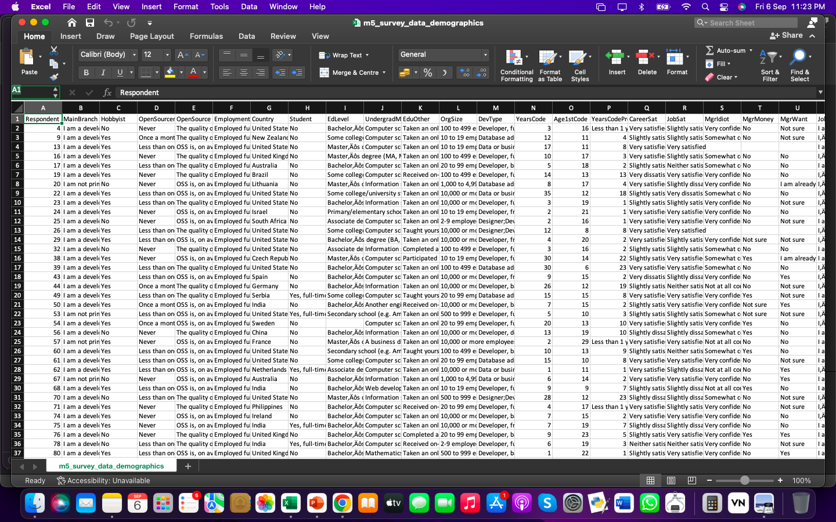
RESULTS
RESULTS ARE BASED ON FOLLOWING DETAILS OF SURVEY

Slide 7
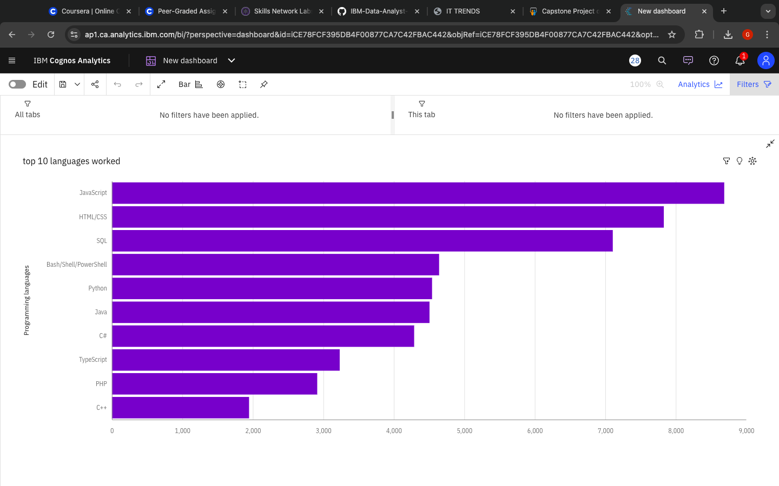
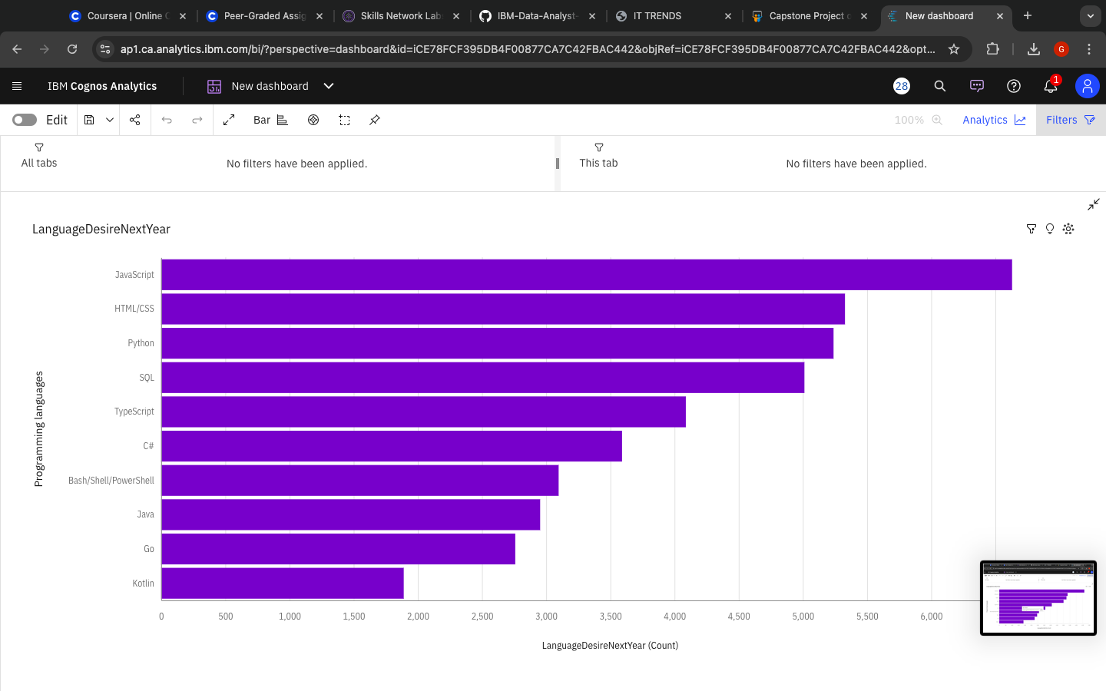
PROGRAMMING LANGUAGE TRENDS
Current Year
Next Year
<Bar chart of top 10 programming languages for the current year goes here.>
< Bar chart of top 10 programming languages for the next year goes here.>

Slide 8
PROGRAMMING LANGUAGE TRENDS - FINDINGS & IMPLICATIONS
Findings
Java Script seems as the first go to language
Most growing- Python
Typescript is going popular among coders
Implications
It looks like some coders are moving from Javascript to Typescript

Slide 9
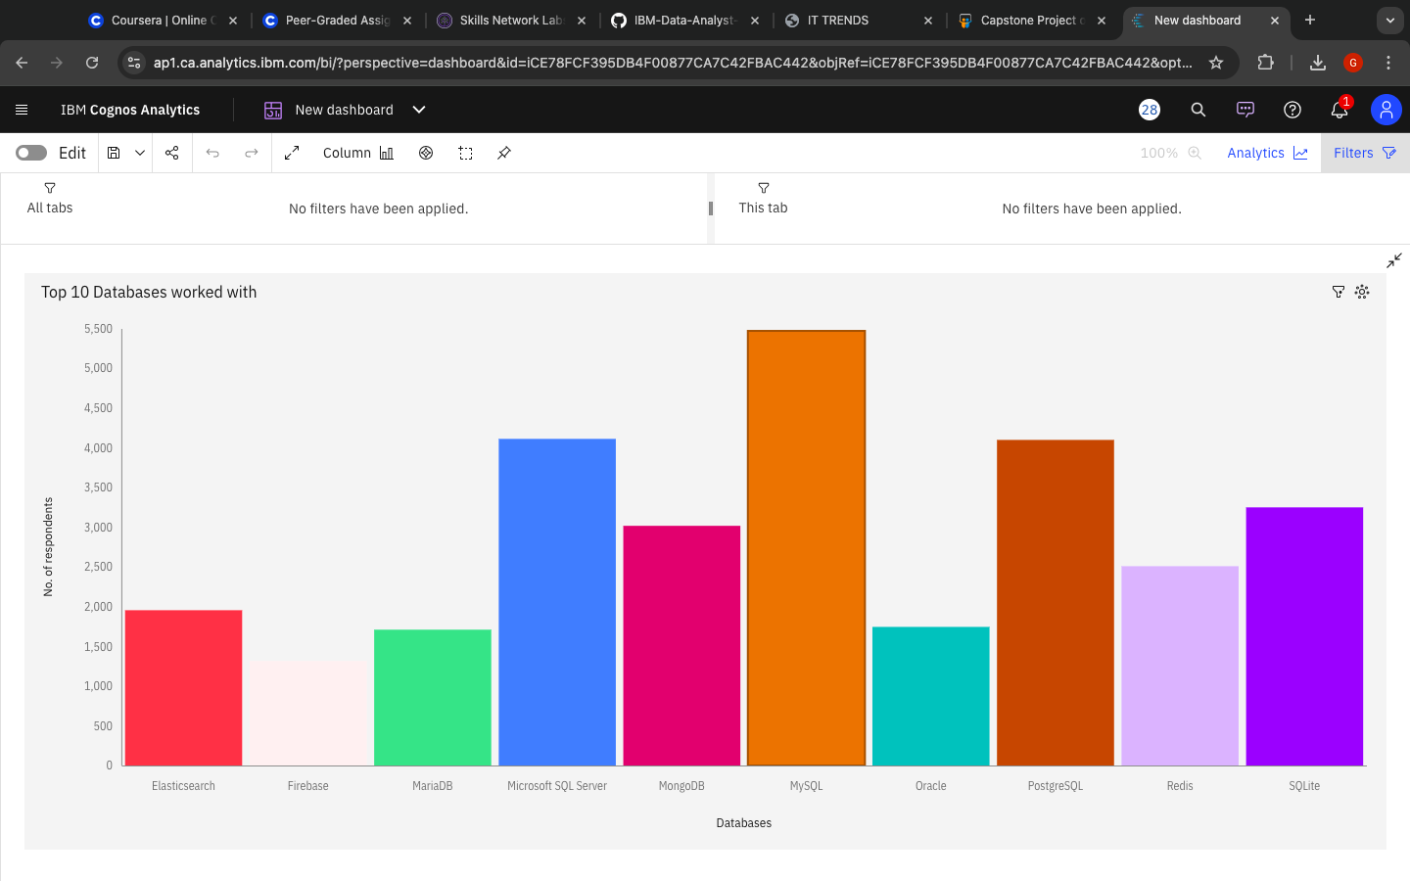
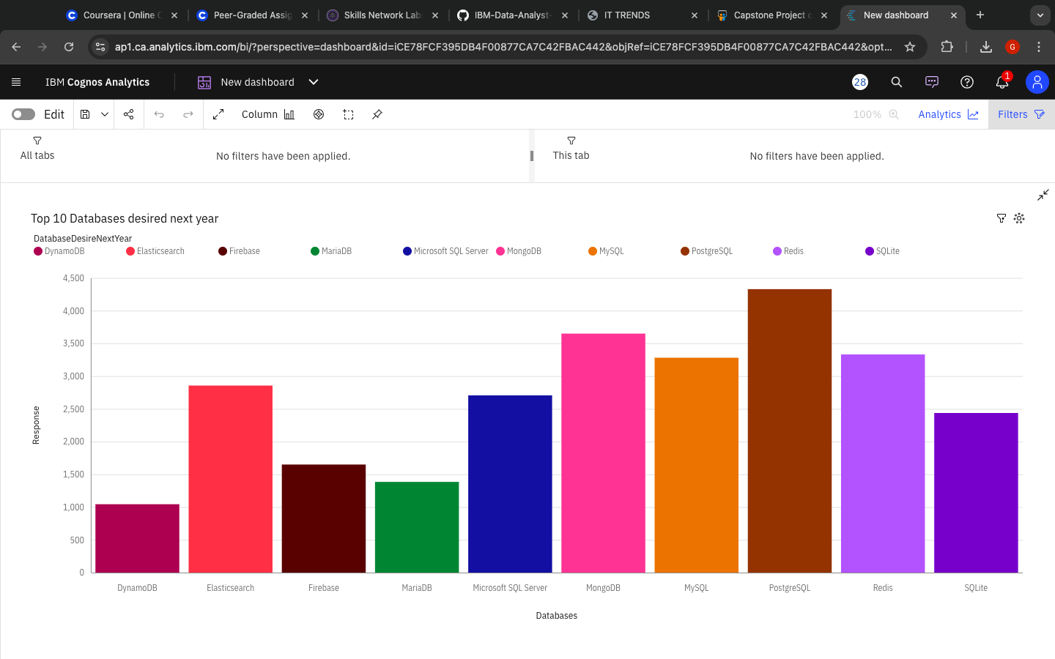
DATABASE TRENDS
Current Year
Next Year
< Bar chart of top 10 databases for the current year goes here >
< Bar chart of top 10 databases for the next year goes here.>

Slide 10
DATABASE TRENDS - FINDINGS & IMPLICATIONS
Findings
Most POPULAR- mySQL
Less interest for Microsoft SQL server and SQlite
PostgreSQL and MongoDB are becoming popular
Implications
Less use of Microsoft Server and SQLite
As seen, PostgreSQL and MongoDB are making good progress

Slide 11

DASHBOARD
https://github.com/garvitmlk/Course-9-IBM-Data-analyst-COGNOS-dashboard/blob/7b6e2e23787b01945aa11c99b81416fc761edaa1/New%20dashboard-%20Cognos%20CRS%209.pdf

Slide 12
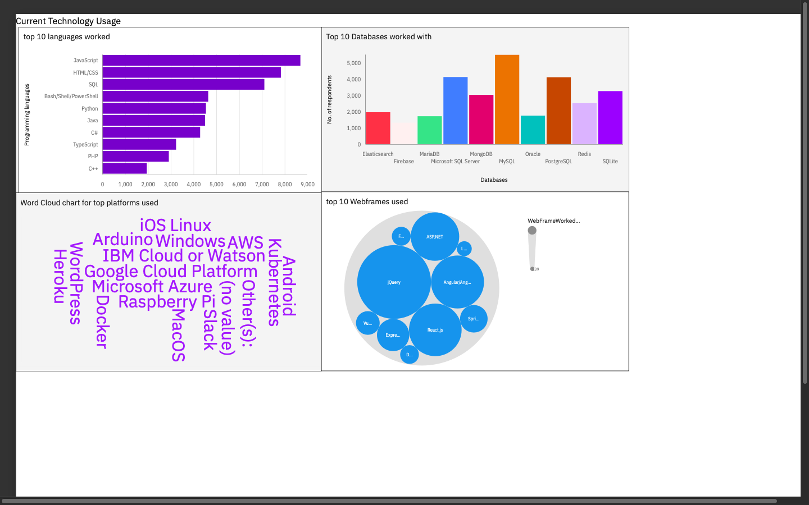
DASHBOARD TAB 1
Screenshot of dashboard tab 1 goes here

Slide 13
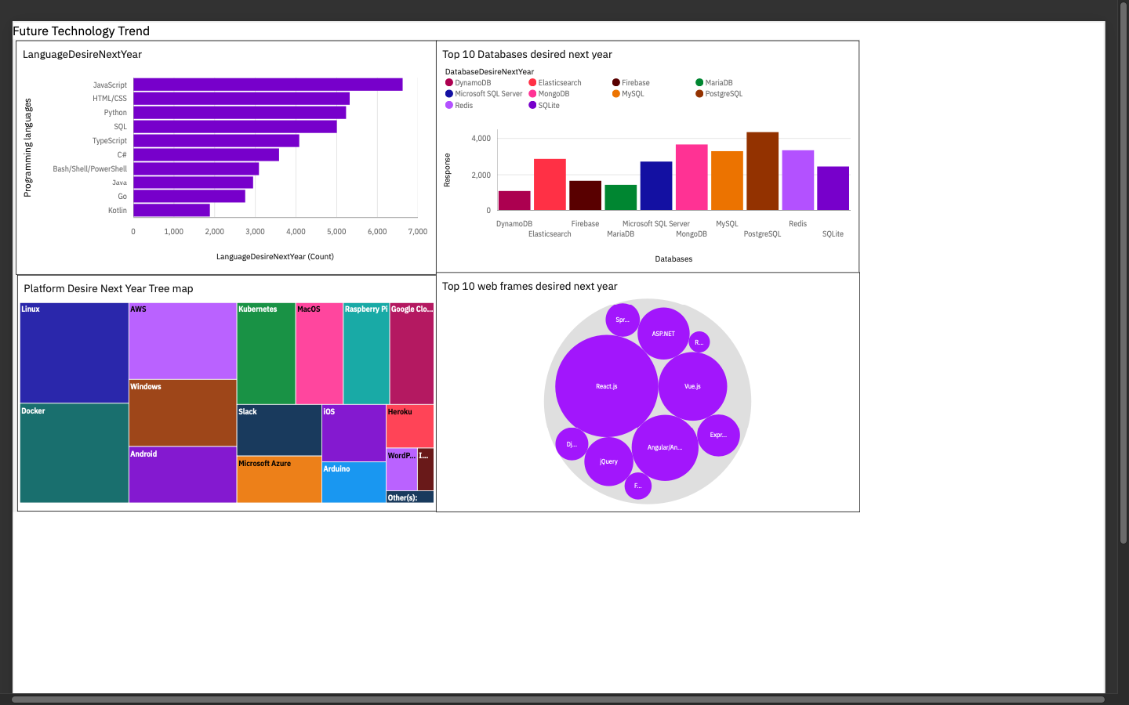
DASHBOARD TAB 2
Screenshot of dashboard tab 2 goes here

Slide 14
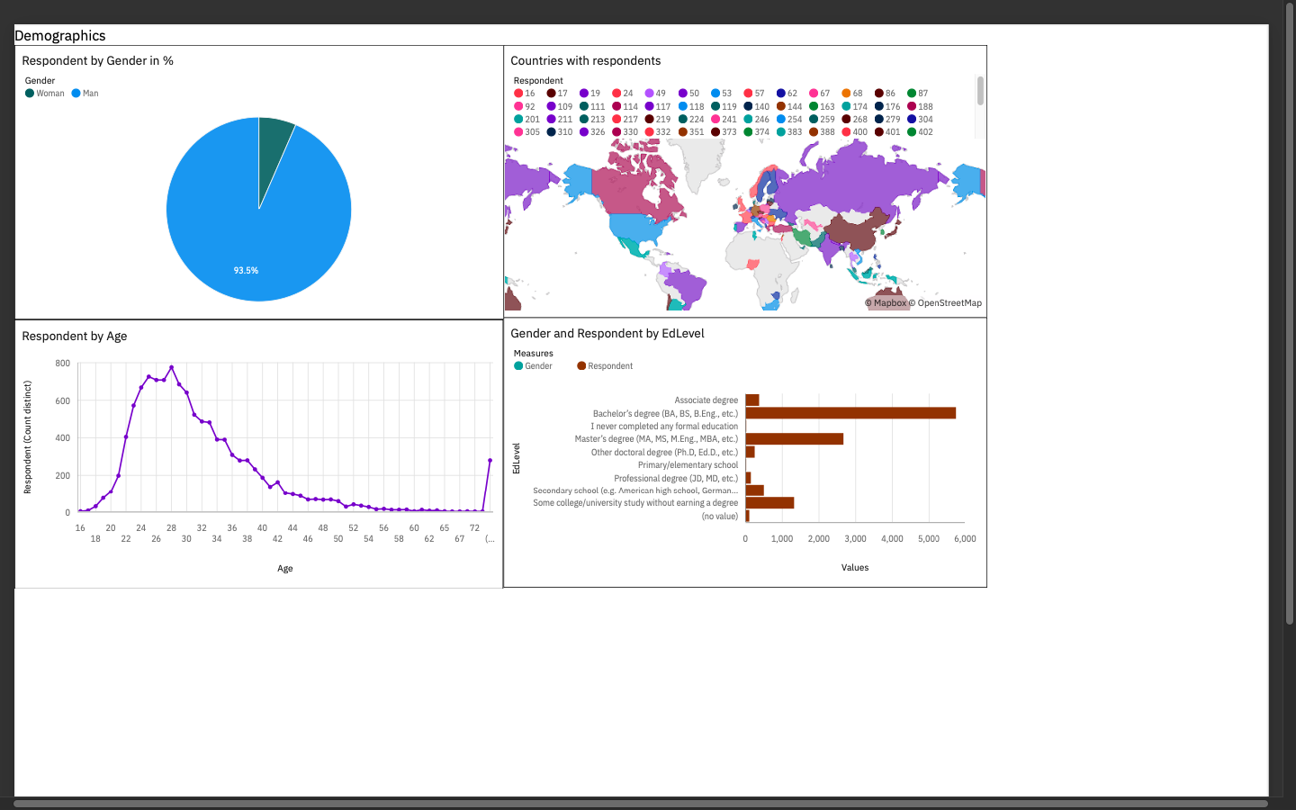
DASHBOARD TAB 3
Screenshot of dashboard tab 3 goes here

Slide 15
DISCUSSION
Technology Trends and future insights.
Bridge divide of technology Gaps
Female participations
Useful for training and educational purposes.

Slide 16
OVERALL FINDINGS & IMPLICATIONS
Findings
Over 90% are young male developers
Less women participation in developer field
Concentration on countries like India and USA
Javascript widely used
Implications
Typescript web following popularity among developers
Young developers without Postgrad education in majority.

Slide 17

CONCLUSION
Demographics overviews like mostly developers are from India and USA
More women participation should be encouraged
More developers should be there except some big countries like India
A idea of how popular databases and languages are in the world the Developers.

Slide 18

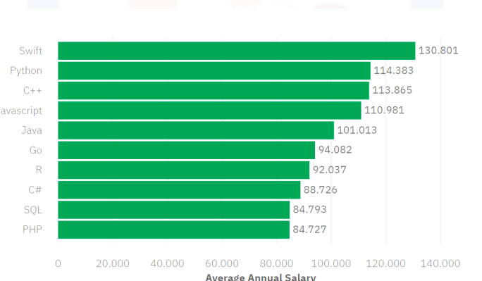
APPENDIX

Slide 19
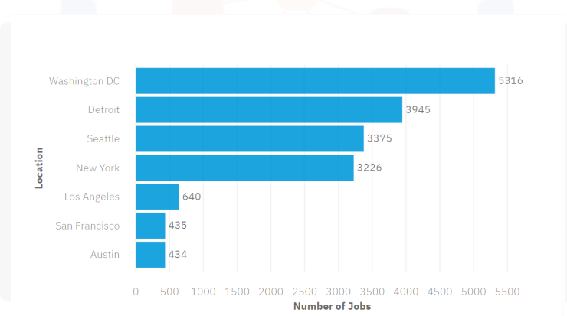
JOB POSTINGS
In Module 1 you have collected the job posting data using Job API in a file named “job-postings.xlsx”. Present that data using a bar chart here. Order the bar chart in the descending order of the number of job postings.

Slide 20
POPULAR LANGUAGES
In Module 1 you have collected the job postings data using web scraping in a file named “popular-languages.csv”. Present that data using a bar chart here. Order the bar chart in the descending order of salary.

